Slide 1
Workforce Skills Certification System (WSCS) Overview
Mt. San Antonio Adult Education Regional Consortium- Fall Regional Summit
Adriana Terry
CASAS
aterry@casas.org
Notes:
9:30 am #1
Introductions
Name, current agency, 1st entry level job (record agency types and jobs on flip chart)
9:45 Intro #2 Hand out WSCS slides and WSCS Implementation Manual
9:50 Activity Employer Survey #3 & 4
With a partner – choose 8 priority soft skills for __??_____ (soft skills) p 6 & 7 (academic skills)
?? Retail; health aid; food service; (typical jobs open in your area)
10:10 Employer hiring decision
Pretend you are the employer looking to hire for ____??____. Compare Employer survey results with Arriana’s profile.
Does Arriana Milas meet basic skill requirements based on profile?? (report back)
10:25 WSCS process #5 (WSCS flyer)
3 steps
10:30 Profile #6 & 7
Academic skills
EFLs
Soft skills
11:00 break
11:15 Develop skills
11:45 Certify skills
12:00 Employer engagement

Slide 2
Workforce Skills Certification System
Goal: To promote transition of learners into the workforce
Objective: Learners will be able to utilize the work readiness skills identified and valued by employers to increase the likelihood of getting and keeping employment
Notes:
UPDATE THESE NUMBERS: Since January of 2010, 7 parole education sites and 5 adult schools in California have participated in a Workforce Skills Certification Project in response to the Transition to Careers ABE initiative. Starting late 2013, NEDP sites in 5 states will begin to pilot WSCS.

Slide 3
How can the WSCS fit into your AEBG Consortium?
WSCS set up to assist AEBG target populations (address barriers)
Can show progress toward AEBG milestones (“Workforce Readiness”)
Coincides with goal to align AEBG and WIOA

Slide 4
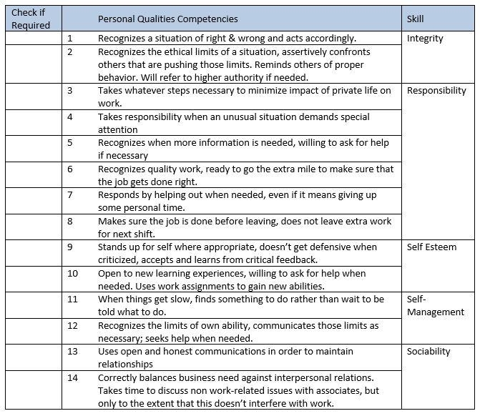
Notes:
9:50 Activity Employer Survey #3 & 4
With a partner choose a job your community has openings in (Retail; health aid; food service; typical jobs open in your area)
Write the job on a post-it and place on table in front of you
Go to employer survey in manual – pages 5-9 in WSCS Manual
Pretend you are an employer for the job on your post-it note and respond to the survey
Take 10 minutes - for Personal Qualities and Customer Care
Take 6 minutes - for Reading and Math skill levels – Write levels on Post-it note
Does Arriana have the skills needed for your job (identified on your sticky) based on your survey?
As an employer, might hyou call her in for an interview? Why or why not?
(report back)
Does Arriana Milas meet basic skill requirements based on profile?? (report back)

Slide 5
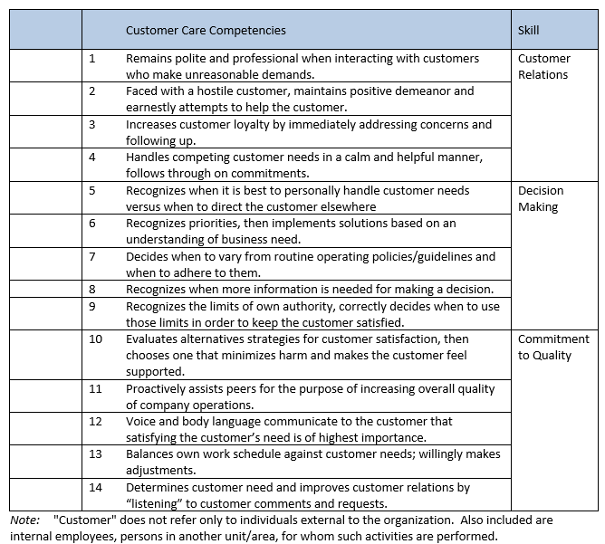
Notes:
9:50 Activity Employer Survey #3 & 4
With a partner choose a job your community has openings in (Retail; health aid; food service; typical jobs open in your area)
Write the job on a post-it and place on table in front of you
Go to employer survey in manual – pages 5-9 in WSCS Manual
Pretend you are an employer for the job on your post-it note and respond to the survey
10 minutes for Personal Qualities and Customer Care
6 minutes for Reading and Math skill levels – Write levels on Post-it note
Compare Employer survey results with Arriana’s profile on Page 10-11
Does Arriana have the skills needed for your job (identified on your sticky) based on your survey?
As an employer, might hyou call her in for an interview? Why or why not?
(report back)

Slide 6
WSCS is a three step process:
Step 1 – Profile & Certify Current Skills
Step 2 – Develop Skills
Step 3 – Certify Improved Skills
Notes:
Page 1 in WSCS Manual
Step 1 - Identify Work Readiness Skills: identify a learner’s work readiness skills (reading, math and workplace behaviors) by administering diagnostic assessments - the results of which are described in a Workforce Skills Profile
Step 2 - Provide Work Readiness Skill Instruction: Utilizing the diagnostic information in the Workforce Skills Profile, offer instruction in workplace behaviors, reading and math.
Step 3 - Certify Work Readiness Skills: When a learner demonstrates a certain level of work readiness skills, administer certification assessments and upon passage of the assessments award a Workforce Skills Certificate

Slide 7
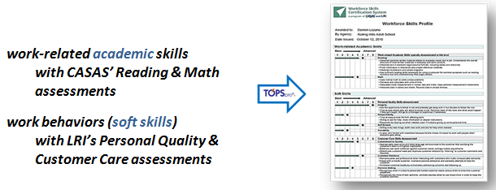
Step 1 – Profile skills

Slide 8
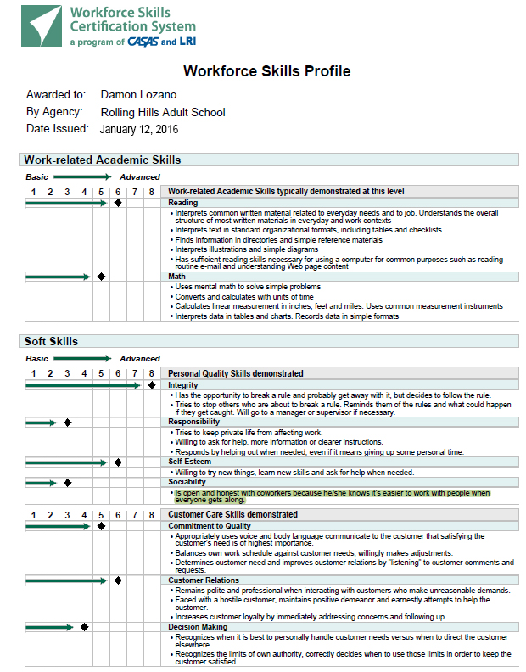
WSCS Profile
Notes:
REFER TO HANDOUT
P 10-11 in binder
This is a visual chart of the options we have in this model to identify BASIC academic and soft skills that a student demonstrates to allow for entry level employment. These skills are outlined on a Workforce Skills Profile.
With additional intervention and support the Client develops the academic and soft skills to earn a Workforce Skills Certificate.

Slide 9
Step 1 – Profile Skills
Administer assessments:
  CASAS Assessments via CASAS eTests
      CASAS Reading – 60 minutes
      CASAS Math – 60 minutes
  LRI Workforce Readiness (soft skills) via the web
      Personal Qualities – 40 minutes
      Customer Service – 37 minutes
Create a Workforce Skills Profile from TOPSpro Enterprise
      Combines results from Reading/Math and Soft Skills Assessment
Notes:
Learners can use the profile to document work readiness skills to help them get a job – even before instruction happens.
LRI Workforce Readiness assessment:
Module 1 - Personal Qualities System is 40 minutes of video during which the viewer responds to 28 work-related questions.
Module 2 - Customer Care System is 37 minutes of video during which the viewer responds to 28 work-related questions.

Slide 10
Why a Workforce Skills Profile?
Documents a person’s work-related academic and
work behavior skills (soft skills)
  Benefit for Learners
    Documents learner’s current work readiness skills:
      What the learner knows
      What skills needs to be developed
  Benefit for employers
    Documents job candidate’s work readiness skills
      Informs employer if prospective employee meets job skill requirements
Notes:
There is a unique description of each skill level that states in positive terms what a person can do. The profile doesn’t state what a person can’t do.
Employers can read the descriptions on the profile and decide if the person has the necessary skill set to do the job.

Slide 11
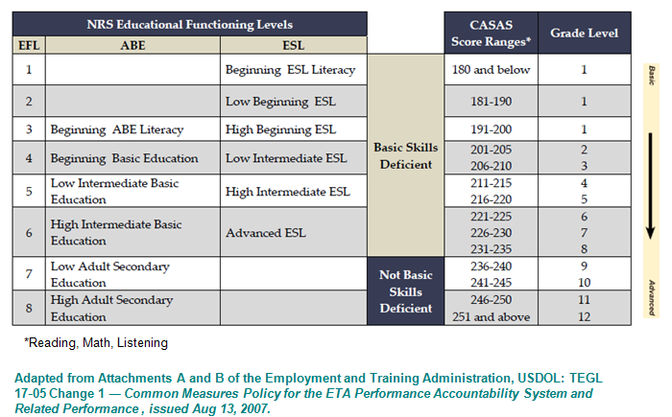
Relating EFLs to the Profile
Profile
Certification
Notes:
Page 15 in WSCS Manual
A person’s CASAS test score results identify current skill levels.
The EFL levels (1 – 8) on the Profile show a person’s current skill levels.
There is a description of each level that states in positive terms what a person can do.
Employers can read the descriptions and decide if the job candidate has the skill set to do the job.
The Educational Functioning Levels (EFL) are used by WIOA I programs to report out academic levels. Use CASAS Scale score levels to know where instruction should begin.
This is another interpretation of the Profile and Certification levels as identified by the CASAS .
Candidates will come into the process at many entry points.
Refer to the HANDOUT that shows all the descriptors at all the levels.

Slide 12

Workplace Behaviors (Soft Skills)
Personal Qualities (PQ)*
  Integrity
  Responsibility
  Self-Esteem
  Self-Management
  Sociability
Customer Care (CC)*
  Customer Relations
  Decision Making
  Commitment to Quality
  *LRI’s Workforce Readiness Skills assessment
  To see samples go to: www.learning-resources.com
Notes:
P 19-20 in WSCS Manual
Review what skills are assessed for Personal Qualities (PQ) and Customer Care (CC)
Do we typically assess these skills?
SHOW LRI Video sample
LRI's programs rely upon and feature carefully researched and employer-validated, video-delivered work-situations to validly and accurately measure the soft or high-performance skills and abilities needed for success in a range of jobs.
Videotaped scenarios simulate work activities and provide possible responses to the interpersonal challenges associated with specific jobs. Participants are asked to select which of the demonstrated responses they would take in these circumstances.
Assessed individuals' skills are compared to a standard of employer-defined effective behavior.
Each video assessment program has been statistically validated prior to its introduction to the marketplace. Personnel from a variety of organizations have been assessed and their results compared with actual on-the-job performance. This provides a statistical measure of how accurately the system assesses job performance. Each assessment program has proven to be four to five times more predictive of job performance than the typical job interview. Equal Employment Opportunity Commission (EEOC) considerations are taken into account in the validation of the video assessments.

Slide 13
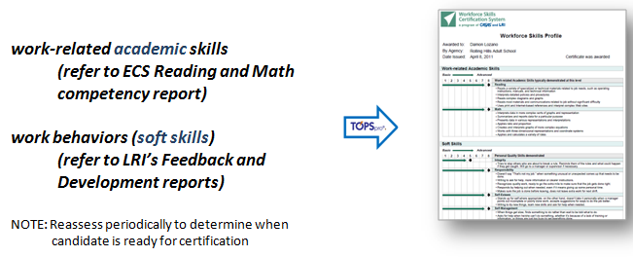
Step 2 - Develop skills

Slide 14
Step 2 - Develop skills
Plan and provide work readiness skill curriculum and instruction:
  Utilize WSCS competencies to plan curriculum
  Utilize diagnostic reports to target instruction
      TOPSpro Enterprise competency reports on learner’s reading and math skills
      LRI Feedback and Development reports on learner’s soft skills
Reassess periodically to measure progress
  Create updated WSCS profile
Notes:
TOPSpro report sample – page 18 in manual
LRI feedback report sample – page 25 in manual

Slide 15
LRI Feedback Report
SOCIABILITY:
You are understanding, friendly, flexible, and polite; when you are around coworkers, you participate in whatever is going on, instead of trying to be “invisible”; you get along well with others; you take an interest in what others say and do.
Situation In Which Your Performance Was Acceptable
Is open and honest with coworkers because he/she knows it’s easier to work with people when you get along with them.
Situation In Which Your Performance Needs Development
Spends some time chatting with coworkers, but not too much. Knows the difference between “down time”, when it’s okay to socialize, and when it’s time to concentrate on work and to let others concentrate on their work.
Notes:
Introduce Feedback report sections
Page 25 in WSCS Manual Cover Page: The name of the individual appears here, along with a statement indicating an individual's probability of success in a specified job. Versions of the report are available for new applicants or incumbents. In each case, a statement appears indicating, for example, that 5 out of 10 people with the same score as John/Jane Doe have been successful in performing the (behavioral skills) activities of their jobs. This page is specifically for the employer – or for those who want to insure that individuals admitted into a program have a minimum level of effective soft skills. We encourage that this page usually not be returned to the assessed person, since it tends to take the focus off of “where do I need to develop to become more effective” and on to a score, as though the score was the substance of the process.
Page 26 Intro to 3 sections
Page 27 Section I - Skills Ranking: This section provides a definition of the skills being measured and ranks the participant's performance of each skill from the strongest (ranked # 1) to the weakest. An "X" denotes those skills in which the participant's performance was above average
Page 28 Section II - Skills and Task Analysis: This section provides an analysis of the tasks that comprise each of the skills assessed by the system. The participant's performance in each task is reported as either being acceptable or needing development. This information can be used to identify training activities within each skill area. Here is an example taken from a customer service assessment program:
One of the tasks measured is Customer Relations, by which is meant an individual's ability to create and maintain a positive company image by interacting with others in a polite, professional, and proactive manner.
The following kind of information is provided, based upon the individual choices made during the assessment:
Situations In Which the Participant's Performance Was Acceptable:
Interacts with customers who make unreasonable demands or have unjustified complaints
Deals with customers regarding service/product complaints
Situations In Which The Participant's Performance Needs Development:
Page 30 Section III - Performance Development Strategies: This section suggests activities to help the participant improve performance in the areas most in need of development. These performance development strategies can be shared with others in the organization in the position to assist in implementing a developmental plan. These suggested strategies are intended to supplement and complement (not replace) other formal developmental activities, such as: training programs, local college courses, books, and other available resources.

Slide 16
LRI Feedback & Development Reports
Identify effective skills and developmental Needs
What developmental option would work for your learners?
  Integrate soft skills into courses:
  Academic and technical, VABE, VESL
  Individual or Group Development plans
  On-line development via learner’s personal
  online account
  Workshops and Job Clubs
  Coaching – Modular Curriculum
  On-line curriculum: Customer Service
  Work Experience and/or Post-Employment Feedback
Notes:
http://www.learning-resources.com/FeedbackReports.cfm – directions on how to interpret Feedback report
These feedback reports can be generated and printed out immediately after a person takes the LRI soft skills assessment.
RESOURCES
Discuss and decide how your program will incorporate soft skills in to instruction and how you will provide individual feedback.
Page 37 in WSCS Manual – Steps for conducting a developmental planning session
Page 39 in WSCS Manual – sample Individual plan
Pages 41-55 Performance development strategies for Personal Qualities
Pages 56- 70 Performance development strategies for Customer Care

Slide 17
Comprehensive Soft Skills Discussion Guide
SKILL: Integrity – You know right from wrong and try to do the right thing.
QUESTION: Assume you are at work and one of your co-workers decides that he wants to leave work 15 minutes early, but does not want the manager to whom you both report to know that he is leaving early. As your co-worker is leaving he explains to you that he is leaving early and asks you to “cover for him” in case your manager comes by and asks where he is. What would you do in this situation?
(Possible probes/additional comments: Assume the Manager comes by and asks you directly where your co-worker is. What would you say? What would you say to the coworker before he leaves?)
Notes:
Page 78 in WSCS manual

Slide 18
Comprehensive Soft Skills Discussion Guide
SAMPLE EFFECTIVE BEHAVIORS:
1. Indicating disagreement with the co-worker’s deceitful actions.
2. Informing the co-worker he/she will not lie to the manager.
3. Indicating that he/she will tell the manager the true story.
SAMPLE INEFFECTIVE BEHAVIORS:
1. Seeing nothing wrong with the co-workers behavior (e.g., it’s not my business).
2. Agreeing to “cover” for the co-worker or play dumb if questioned by the manager.
3. Indicating disagreement with the co-worker’s actions, but a reluctance to state views to the co-worker
Notes:
Page 78 in WSCS Manual

Slide 19
Prepare for Critical Thinking and Problem Solving
  The WSCS Critical Thinking test questions :
    are analytical in nature
    involve making observations, inferences, and deductions, drawing conclusions, and making decisions.
    include selecting an answer from given responses
  The WSCS Problem-Solving test questions:
    reflect a six-step problem-solving model:
      1 – Identify the problem
      2 – Identify possible causes of the problem
      3 – Identify solutions to the problem
      4 – Implement a plan to solve the problem
      5 – Evaluate the solution
      6 – Modify the solution
    include selecting an answer from given responses and writing original responses
Notes:
It is critical that you prepare learners in critical thinking and problem solving well before they take WSCS certification tests. Page 13-14 in WSCS Manual
The Problem Solving tests consists of a work-related situation and six questions based on a six-step problem-solving model:
1 – Identify the problem
2 – Identify possible causes of the problem
3 – Identify solutions to the problem
4 – Implement a plan to solve the problem
5 – Evaluate the solution
6 – Modify the solution
Some of the questions involve selecting an answer from given responses and others require a written response.
NOTE: Answers are captured in CASAS eTests and are automatically sent to CASAS to be scored by certified scorers who follow standardized scoring guidelines. Results are returned and are automatically captured in TOPSpro in the examinees profile.

Slide 20
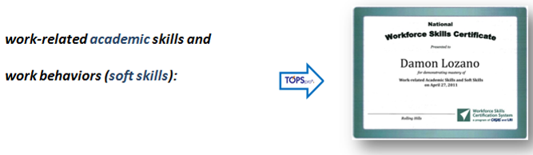
Step 3 – Certify Skills

Slide 21
Step 3 – Certify Skills
Administer certification tests via CASAS eTests:
a. CASAS WSCS – Form 551
        Reading (40 minutes)
        Math (40 minutes)
  b. CASAS Critical Thinking (15 minutes)
c. CASAS Problem Solving (25 minutes)
d. LRI Workforce Readiness - soft skills
        Personal Qualities (40 minutes)
        Customer Care (37 minutes)
Note: only administer LRI soft skills assessment if student has not yet achieved level 6 overall in both sections.
Notes:
Page 12 in WSCS Manual

Slide 22
Work-related Academic Skills
Form 551 assesses academic skills
  Reading
    interpreting manuals, forms, diagrams, charts, signs
    other types of workplace documentation
  Math
    application of math skills to job-related tasks/situations
    basic computation
    decimals, fractions, percent, ratios
    simple applied algebra
Notes:
The Reading Comprehension test contains 36 multiple-choice items that involve interpreting manuals, forms, diagrams, charts, signs and other types of workplace documentation.
2. Math
The Math test contains 35 multiple-choice items that address a range of math skills used on the job, including basic computation, decimals, fractions, percents, ratio and simple applied algebra. Items require applying math skills to job-related tasks or situations.

Slide 23
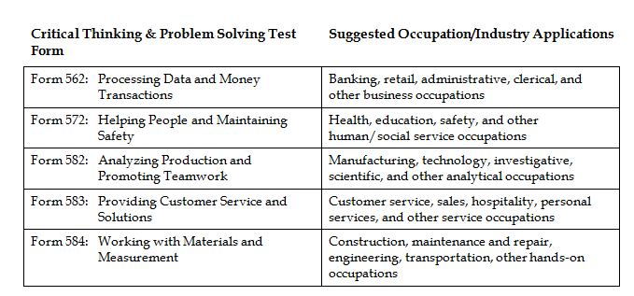
Critical Thinking and Problem Solving
Choose the test that best matches a learner’s work experience and/or career interest.
Notes:
Page 13 in WSCS Manual

Slide 24
Step 3 – Award Workforce Skills Certificate
Workforce Skills Certificate is awarded when a learner scores:
  on WSCS Form 551
        246 or above in Reading
        240 or above in Math
  on WSCS Critical Thinking – pass
  on WSCS Problem solving – pass
  on LRI Customer Care – 6 or above
  on LRI Personal Qualities – 6 or above
  Note: If a learner does not score high enough to earn a certificate, print out an updated WSCS Profile for him/her.
Notes:
Page 15 in WSCS Manual

Slide 25
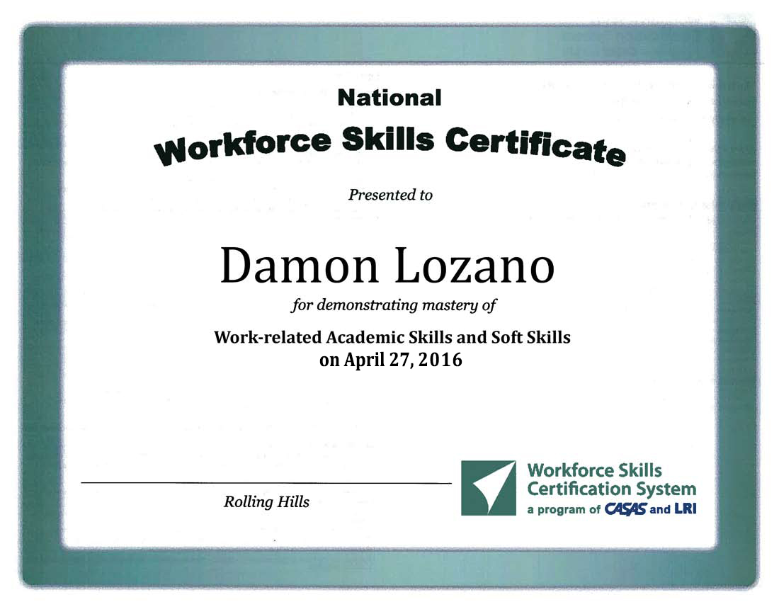

Slide 26
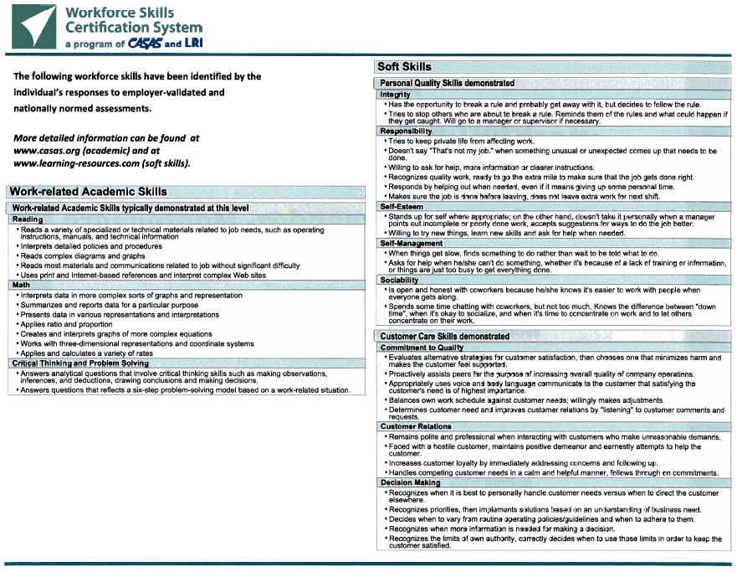

Slide 27
Wrapping Up
Resources
LRI Workplace Behaviors (Soft Skills)
www.learning-resources.com
CASAS
www.casas.org
wscs@casas.org

